Slide 1

Compiler Design
Preet Kanwal
Department of Computer Science & Engineering
Teaching Assistant : Kavya P K

Slide 2

Compiler Design
Unit 3: Intermediate Code Generation
Preet Kanwal
Department of Computer Science & Engineering

Slide 3
Compiler Design Lecture Overview
In this lecture, you will learn about -
What is intermediate code?
Why intermediate code generation?
Advantages of ICG
Types of Intermediate Representation
Directed Acyclic Graph
Applications
SDD to construct a DAG
Examples of Syntax tree vs DAG

Slide 4
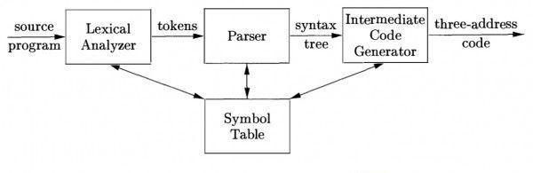
Compiler Design
What is Intermediate code?
Intermediate code is used to translate the source code into the machine code.
It lies between the high-level language and the machine language.
The Intermediate code generator receives input from the semantic analyzer. It takes input in the form of an annotated syntax tree.
Using the intermediate code, the second phase of the compiler (synthesis phase) is changed according to the target machine.

Slide 5
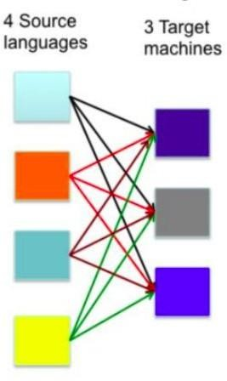
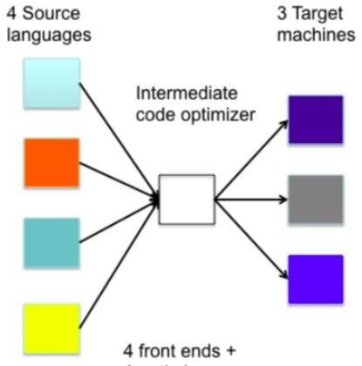
Compiler Design
Why Intermediate code generation?
Intermediate code eliminates the need of a new full compiler for every unique machine by keeping the analysis portion same for all the compilers.
4 front-ends + 4x3 optimisers + 4x3 code generators
4 front-ends + 1 optimiser +
3 code

Slide 6
Compiler Design
Advantages ofIntermediate Code Generation
ICG makes it easier to construct compilers for different architectures.
Targetcode can be generated for any machine just by attaching new machine as the back end - this is called retargeting.
It is possible to apply machine independent code optimization - helps in faster generation of code.

Slide 7
Compiler Design
Types of Intermediate Representation
An intermediate representation is a representation of a program between the source and target languages.
A good IR is one that is fairly independent of the source and target languages - this maximizes its ability to be used in a retargetable compiler.
There are three ways to classify Intermediate representation:
High-level or Low-level
Language-specific or Language independent
Graphical or Linear

Slide 8
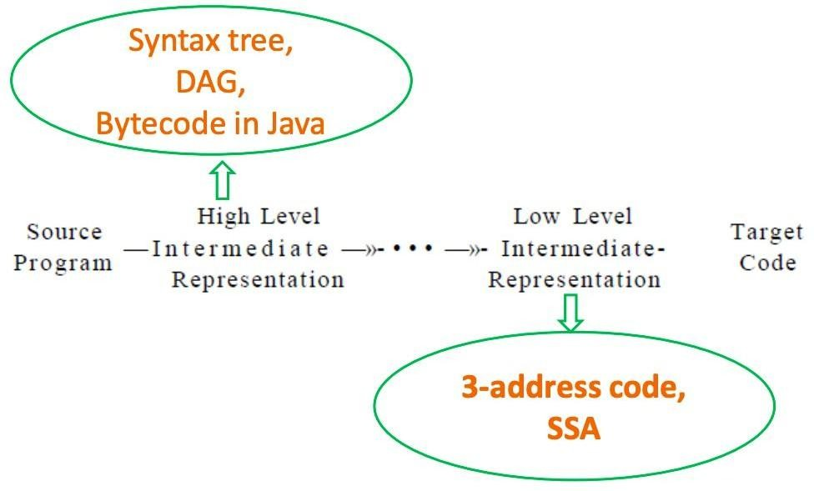
Compiler Design
Intermediate Representation - High level vs Low level
representation

Slide 9
Compiler Design
Intermediate Representation - High level representation
High-level intermediate code representation is very close to the source language itself.
They can be easily generated from the source code
Code modifications can be easily applied to enhance performance.
Examples- Syntax trees, DAG, Java Bytecode

Slide 10
Compiler Design
Intermediate Representation - Low level representation
Low level intermediate code representation is close to the target machine.
This makes it suitable for register and memory allocation, instruction set selection, etc.
It is good for machine-dependent optimizations.
Examples - Three Address Code, SSA

Slide 11
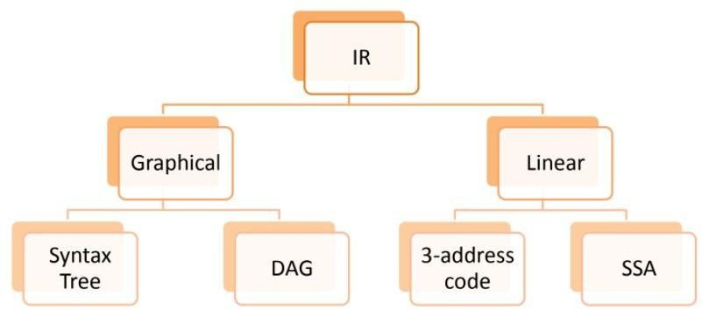
Compiler Design Intermediate
Representation
In terms of language, Intermediate code can be either -
Language specific - Byte Code for Java, P-code for Pascal
Language independent - three-address-code
Intermediate code can be also classified as -
Graphical
Linear

Slide 12
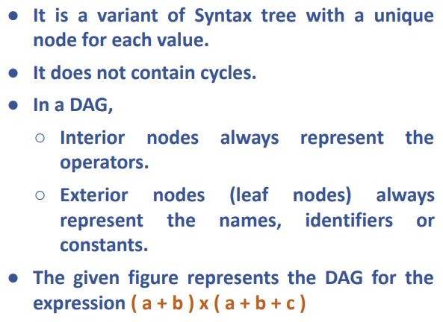
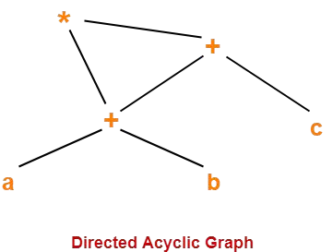
Compiler Design
DAG - Directed Acyclic Graph

Slide 13
Compiler Design Applications of
DAG
It helps optimize code by identifying common subexpressions in a syntax tree.
It reduces no. of calculations to be done - calculate once, refer anywhere.
It can be used to determine the names whose computation has been done outside the block but used inside the block.
It can also be used to determine the statements of the block whose computed value can be made available outside the block.

Slide 14
Compiler Design
SDD to construct a DAG
SDD used to generate Syntax tree will be used to construct DAG too, with a simple check -
if an identical node exists
RETURN existing node
else
CREATE a new node
The assignment instructions of the form x:=y are not performed unless they are necessary.
The process of making this check is an overhead; hence constructing DAG is costly.

Slide 15
Compiler Design
Exercise 1 - Construct DAG for the given expression
Consider the following unambiguous grammar - E -> E + T | E – T | T
T -> T * F | T / F | F
F -> ( E ) | [ E ] | id
Using this, construct Syntax tree and DAG for the following expression - ((x + y) – ((x + y) * (x – y ))) + ((x + y) * (x – y ))

Slide 16
Compiler Design Exercise 1 - Solution
Given - ((x + y) – ((x + y) * (x – y ))) + ((x + y) * (x – y ))
Step 1 - Rewrite the expression for clear understanding
(
(x + y) - (
(x + y) * (x - y)
)
)
+ (
(x + y) * (x - y)
)

Slide 17
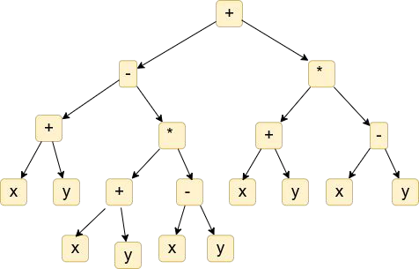
Compiler Design Exercise 1 - Solution
Given - ((x + y) – ((x + y) * (x – y ))) + ((x + y) * (x – y ))
Step 2 - Draw the Syntax tree

Slide 18
Compiler Design Exercise 1 - Solution
Given - ((x + y) – ((x + y) * (x – y ))) + ((x + y) * (x – y ))
Step 3 - Identify the common subexpressions and eliminate step wise

Slide 19
Compiler Design Exercise 2
Consider the following unambiguous grammar - E -> E + T | E – T | T
T -> T * F | T / F | F
F -> ( E ) | [ E ] | id
Using this, construct Syntax tree and DAG for the following expressions -
a + b + a + b
a + b + ( a + b )
a + a * (b – c ) + ( b – c ) * d
(((a + a) + ( a + a)) + ((a + a) + ( a + a)))
[(a + b) ∗ c + ((a + b) + e) ∗ (e + f )] ∗ [(a + b) ∗ c]

Slide 20
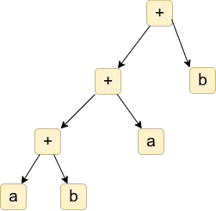
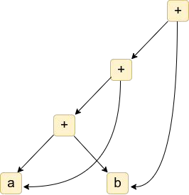
Compiler Design Exercise 2 - Solutions
1) a + b + a + b

Slide 21
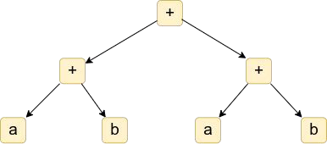
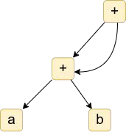
Compiler Design Exercise 2 - Solutions
2) a + b + ( a + b )

Slide 22
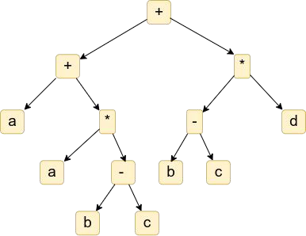
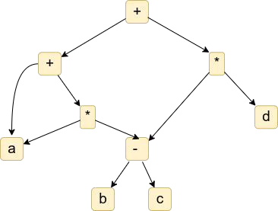
Compiler Design Exercise 2 - Solutions
3) a + a * (b – c ) + ( b – c ) * d

Slide 23
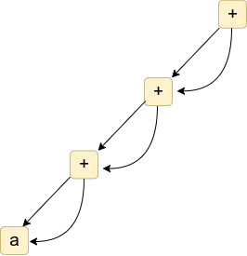
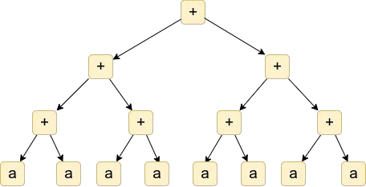
Compiler Design Exercise 2 - Solutions
4) (((a + a) + ( a + a)) + ((a + a) + ( a + a)))

Slide 24
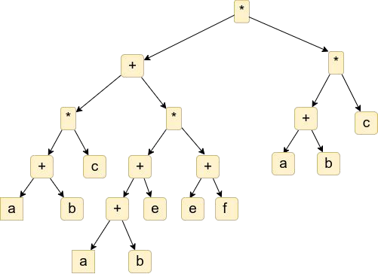
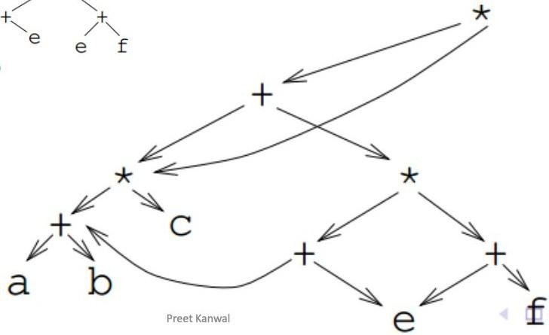
Compiler Design Exercise 2 - Solutions
5)[(a + b) ∗ c + ((a + b) + e) ∗ (e + f )] ∗ [(a + b) ∗ c]

Slide 25
THANK YOU
Preet Kanwal
Department of Computer Science & Engineering
preetkanwal@pes.edu

